Slide 1
جبر بول
Boolean Algebra

Slide 2
جبر بول
قوت اصلي سيستم هاي ديجيتال:
  جامعيت و قدرت فرمولاسيون رياضي جبر بول
مثال:
IF the lift door is closed
AND a button is pressed at a floor
THEN the lift must move
هر دو شرط:
the lift door is closed و
a button is pressed at a floor بايد true باشند تا آسانسور حرکت کند.

Slide 3
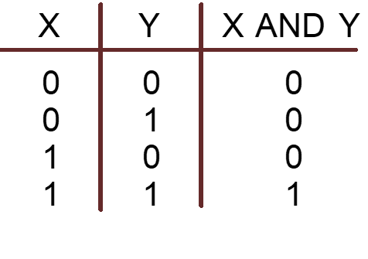
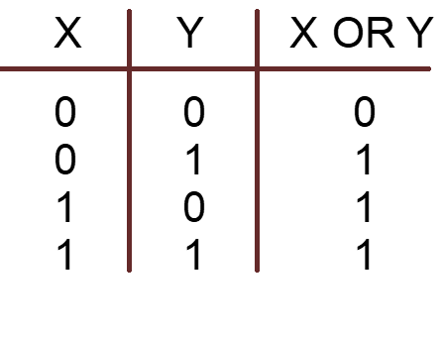
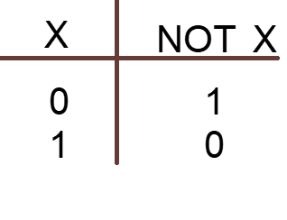
Digital Systems: Boolean Algebra and Logical Operations
In Boolean algebra:
  Values: 0,1
  0: if a logic statement is false,
  1: if a logic statement is true.
Operations: AND, OR, NOT

Slide 4
مثال
IF the lift door is closed
AND a button is pressed at a floor
THEN the lift must move
door closed?
button pressed?
move lift?
false/0
false/0
true/1
true/1
false/0
true/1
false/0
true/1
false/0
false/0
false/0
TRUE/1

Slide 5
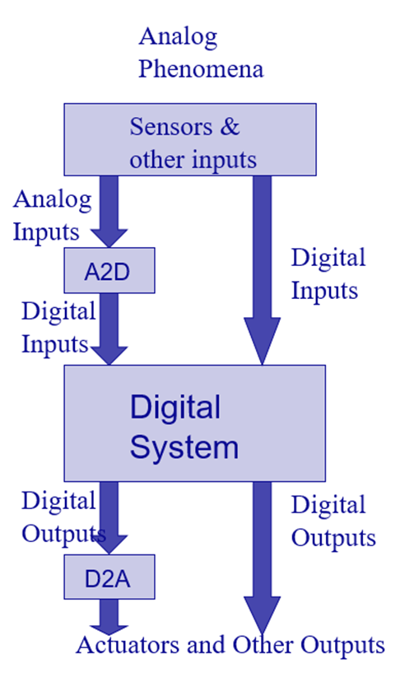
سيستم هاي نوعي
System
ورودي ها:
  فشار کليد (ديجيتال)
  درجةحرارت محيط (آنالوگ)
  تغييرات سطح مايع (آنالوگ)
خروجي ها:
  ولتاژ راه اندازي موتور (آنالوگ)
  بازکردن/بستن شير (آنالوگ يا ديجيتال)
  نمايش روي LCD (ديجيتال)

Slide 6
مثال: دستگاه اطفاي حريق خودکار
Analog Phenomena
Sensors & other inputs
System
Analog Inputs
Digital Inputs
A2D
Digital Inputs
رفتار سيستم:
  اگر درجة حرارت محيط از مقدار مشخصي بيشتر است و کليد فعال سازي دستگاه روشن است، شير آب را باز کن.
Digital System
Digital Outputs
Digital Outputs
D2A
Actuators and Other Outputs

Slide 7

مثال: چراغ هشدار کمربند ايمني
Analog Phenomena
Sensors & other inputs
Analog Inputs
Digital Inputs
A2D
Digital Inputs
Digital System
  S = ‘1’: کمربند بسته است.
  K = ‘1’: سوييچ داخل است.
  P = ‘1’: راننده روي صندلي است.
Digital Outputs
Digital Outputs
D2A
Actuators and Other Outputs

Slide 8
سوييچ ها: عملگرهاي منطقي
IF the lift door is closed
AND a button is pressed at a floor
AND “Open” button is off
THEN the lift must move
Door
closed
Button
pressed
Open
off
T
Move lift
rue
Open button
Button
at a floor
Open
Is off
Door
closed
IF ((a button pressed at a floor
AND “Open” button is off)
OR a button inside the lift is pressed)
AND the door lift is closed
THEN the lift can move
True
Move lift
True
Button
inside

Slide 9
Binary Logic
  Deals with binary variables that take 2 discrete values (0 and 1), and with logic operations
  Basic logic operations:
    AND, OR, NOT
  Binary/logic variables are typically represented as letters: A,B,C,…,X,Y,Z

Slide 10
Binary Logic Function
F(متغیر ها) = عبارت
Example:
F(a,b) = a’•b + b’
G(x,y,z) = x•(y+z’)
متغیر ها (A , B , C ,…)
عملگر ها ( +, •, ‘ )
گروه بندی ها ( ( , ) )
ثابت ها ( 0, 1 )
مجموعه ای از متغیر های
دودویی

Slide 11
Basic Logic Operators
  AND (also •, )
  OR (also +, )
  NOT (also ’, )
  F(a,b) = a•b, reads F is 1 if and only if a=b=1
  G(a,b) = a+b, reads G is 1 if either a=1 or b=1 or both
H(a) = a’, reads H is 1 if a=0
Binary
Unary

Slide 12
Basic Logic Operators (cont.)
1-bit logic AND resembles binary multiplication:
  0 • 0 = 0, 0 • 1 = 0,
  1 • 0 = 0, 1 • 1 = 1
1-bit logic OR resembles binary addition, except for one operation:
  0 + 0 = 0, 0 + 1 = 1,
  1 + 0 = 1, 1 + 1 = 1 (≠ 10₂)
-

Slide 13
Truth Tables for logic operators
Truth table:
tabular form that uniquely represents the relationship between the input variables of a function and its output
2-Input AND
2-Input OR
NOT
A | B | F=A•B
0 | 0 | 0
0 | 1 | 0
1 | 0 | 0
1 | 1 | 1
A | B | F=A+B
0 | 0 | 0
0 | 1 | 1
1 | 0 | 1
1 | 1 | 1
A | F=A’
0 | 1
1 | 0

Slide 14
Truth Tables (cont.)
Q:
  Let a function F() depend on n variables. How many rows are there in the truth table of F() ?
A:
  2^{n} rows, since there are 2^{n} possible binary patterns/combinations for the n variables

Slide 15
Logic Gates
  Logic gates are abstractions of electronic circuit components that operate on one or more input signals to produce an output signal.
2-Input AND
2-Input OR
NOT (Inverter)
A
A
F
G
A
H
B
B
H = A’
F = A•B
G = A+B

Slide 16
Timing Diagram
t₀
t₁
t₂
t₃
t₄
t₅
t₆
A
1
Input
signals
0
1
Transitions
B
0
F=A•B
1
0
Basic
Assumption:
Zero time for
signals to
propagate
Through gates
Gate
Output
Signals
G=A+B
1
0
H=A’
1
0

Slide 17
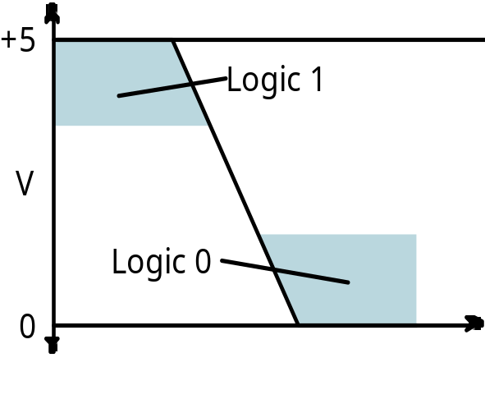
The Real World
  Physical electronic components are continuous, not discrete!
    Transition from logic 1 to logic 0 does not take place instantaneously in real digital systems
  These are the building blocks of all digital components!
  Intermediate values may be visible for an instant
  Boolean algebra useful for describing the steady state behavior of digital systems
  Be aware of the dynamic, time varying behavior too!
Time

Slide 18
Circuit that implements logical negation (NOT)
Logic 0 Input
+5
Voltage
Inverter behavior as a function of input voltage
input ramps from 0V to 5V
output holds at 5V for some range of small input voltages
then changes rapidly, but not instantaneously!
V
Out
Logic 1 Input
Voltage
0
V
+5
In

Slide 19
Combinational Logic Circuit from Logic Function
Combinational Circuit Design:
F = A’ + B•C’ + A’•B’
  connect input signals and logic gates:
    Circuit input signals → from function variables (A, B, C)
    Circuit output signal → function output (F)
    Logic gates → from logic operations
C
A
F
B

Slide 20
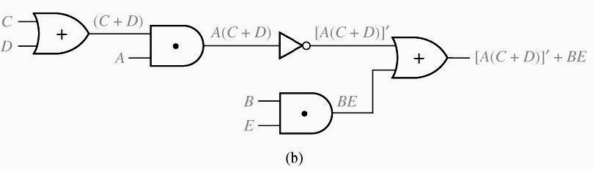
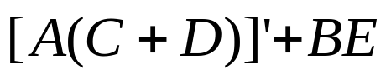
Logic Evaluation
Circuit of logic gates :
Logic Expression :
Logic Evaluation : A=B=C=1, D=E=0

Slide 21
Combinational Logic Optimization
  In order to design a cost-effective and efficient circuit, we must minimize
    the circuit’s size
      area
    propagation delay
      time required for an input signal change to be observed at the output line
  Observe the truth table of
    F=A’ + B•C’ + A’•B’ and
    G=A’ + B•C’
  are identical → same function
  Use G to implement the logic circuit
    less components
A | B | C | F | G
0 | 0 | 0 | 1 | 1
0 | 0 | 1 | 1 | 1
0 | 1 | 0 | 1 | 1
0 | 1 | 1 | 1 | 1
1 | 0 | 0 | 0 | 0
1 | 0 | 1 | 0 | 0
1 | 1 | 0 | 1 | 1
1 | 1 | 1 | 0 | 0

Slide 22
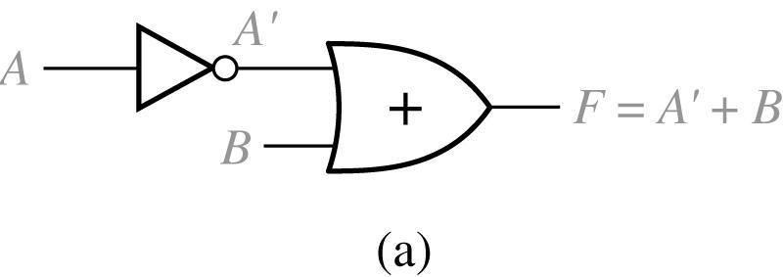
Logic Evaluation
2-Input Circuit and Truth Table
A B |  | A’ | F = A’ + B
0 0 0 1 1 0 1 1 |  | 1 1 0 0 | 1 1 0 1

Slide 23
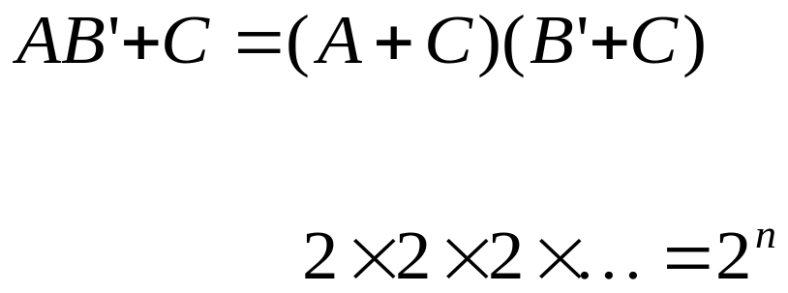
Proof Using Truth Table
n variable needs rows
n times
A B C |  | B’ | AB’ | AB’ + C |  | A + C | B’ + C | (A + C) (B’ + C)
0 0 0 0 0 1 0 1 0 0 1 1 1 0 0 1 0 1 1 1 0 1 1 1 |  | 1 1 0 0 1 1 0 0 | 0 0 0 0 1 1 0 0 | 0 1 0 1 1 1 0 1 |  | 0 1 0 1 1 1 1 1 | 1 1 0 1 1 1 0 1 | 0 1 0 1 1 1 0 1

Slide 24
Combinational Logic Optimization
C
    F=A’ + B•C’ + A’•B’
A
F
B
C
    G=A’ + B•C’
B
A
G

Slide 25
Boolean Algebra
  VERY nice machinery used to manipulate (simplify) Boolean functions
  George Boole (1815-1864): “An investigation of the laws of thought”
  Terminology:
    Literal: A variable or its complement
      A, B’, x’
    Product term: literals connected by •
      X.Y
      A.B’.C.D,
    Sum term: literals connected by +
      A+B’
      A’+B’+C

Slide 26
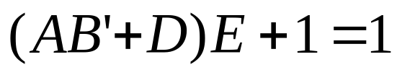
Boolean Algebra Properties
Let X: boolean variable,
0,1: constants
  X + 0 = X -- Zero Axiom
  X • 1 = X -- Unit Axiom
  X + 1 = 1 -- Unit Property
  X • 0 = 0 -- Zero Property
A | B | F=A+B
0 | 0 | 0
0 | 1 | 1
1 | 0 | 1
1 | 1 | 1
A | B | F=A•B
0 | 0 | 0
0 | 1 | 0
1 | 0 | 0
1 | 1 | 1
Example:

Slide 27
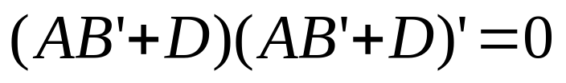
Boolean Algebra Properties (cont.)
A | B | F=A+B
0 | 0 | 0
0 | 1 | 1
1 | 0 | 1
1 | 1 | 1
Let X: boolean variable,
0,1: constants
  X + X = X -- Idempotent
  X • X = X -- Idempotent
  X + X’ = 1 -- Complement
  X • X’ = 0 -- Complement
  (X’)’ = X -- Involution
A | B | F=A•B
0 | 0 | 0
0 | 1 | 0
1 | 0 | 0
1 | 1 | 1
Example:

Slide 28
The Duality Principle
  The dual of an expression is obtained by exchanging (• and +), and (1 and 0) in it,
    provided that the precedence of operations is not changed.
  Do not exchange x with x’
  Example:
    Find H(x,y,z), the dual of F(x,y,z) = x’yz’ + x’y’z
    H = (x’+y+z’) (x’+y’+ z)
  Dual does not always equal the original expression
If a Boolean equation/equality is valid, its dual is also valid

Slide 29
The Duality Principle (cont.)
  With respect to duality, Identities 1 – 8 have the following relationship:
1. X + 0 = X 2. X • 1 = X (dual of 1)
3. X + 1 = 1 4. X • 0 = 0 (dual of 3)
5. X + X = X 6. X • X = X (dual of 5)
7. X + X’ = 1 8. X • X’ = 0 (dual of 8)

Slide 30
More Boolean Algebra Properties
Let X,Y, and Z: boolean variables
10. X + Y = Y + X 11. X • Y = Y • X -- Commutative
12. X + (Y+Z) = (X+Y) + Z 13. X•(Y•Z) = (X•Y)•Z -- Associative
14. X•(Y+Z) = X•Y + X•Z 15. X+(Y•Z) = (X+Y) • (X+Z)
-- Distributive
16. (X + Y)’ = X’ • Y’ 17. (X • Y)’ = X’ + Y’ -- DeMorgan’s
In general,
( X₁ + X₂ + … + X_{n} )’ = X₁’•X₂’ • … •X_{n}’
( X₁•X₂•… •X_{n} )’ = X₁’ + X₂’ + … + X_{n}’

Slide 31

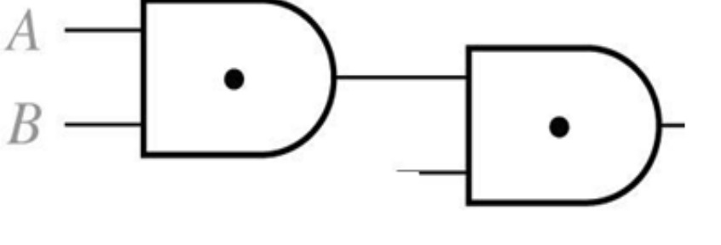
Associative Laws for AND
B
A
C
=
B
A
C
A(BC)=ABC

Slide 32
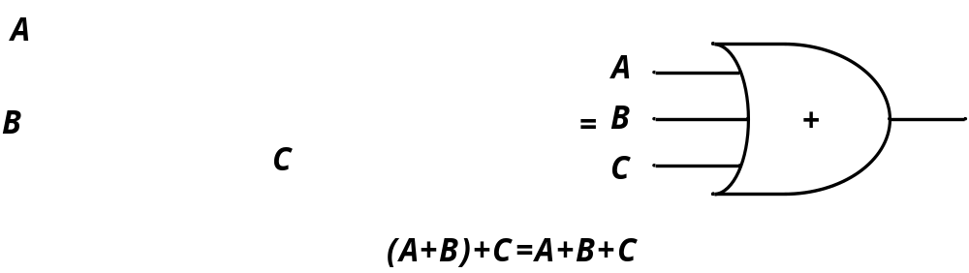
Associative Laws for OR

Slide 33
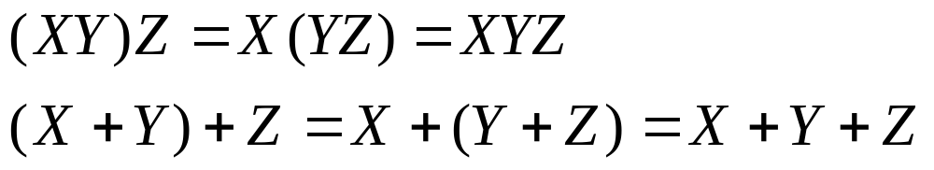
Proof of Associative Law
Associative Laws:
Proof of Associative Law for AND
X Y Z |  | XY YZ | (XY)Z X(YZ)
0 0 0 0 0 1 0 1 0 0 1 1 1 0 0 1 0 1 1 1 0 1 1 1 |  | 0 0 0 0 0 0 0 1 0 0 0 0 1 0 1 1 | 0 0 0 0 0 0 0 0 0 0 0 0 0 0 1 1

Slide 34
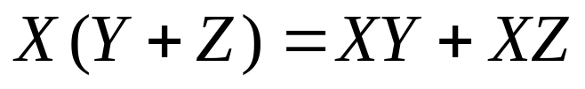

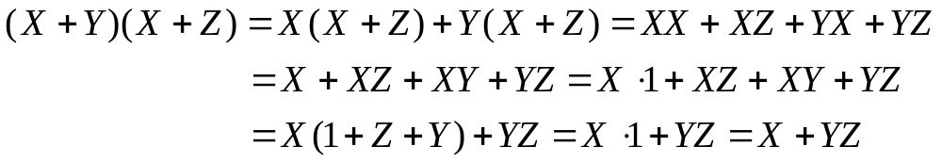
Distributive Law
Distributive Laws:
Valid only for Boolean algebra not for ordinary algebra
(A+B).C = A.C + B.C
Proof of the second law:
C

Slide 35
Absorption Property (Covering)
  x + x•y = x
  x•(x+y) = x (dual)
Proof:
x + x•y = x•1 + x•y
= x•(1+y)
= x•1
= x
QED (2 true by duality)

Slide 36
Absorption Property (Covering)
  x + x’•y = x + y
  x•(x’+y) = x y (dual)
Proof of 2:
x • (x’+ y) = x•x’ + x•y
= 0 + (x•y)
= x•y
QED (1 true by duality)

Slide 37
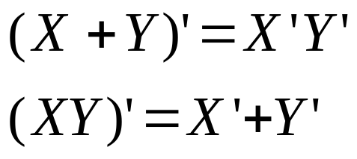
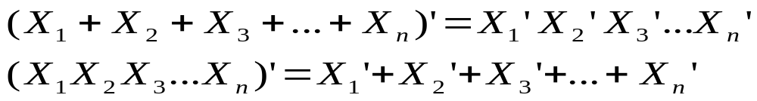
DeMorgan’s Laws
Proof
X Y |  | X’ Y’ | X + Y | ( X + Y )’ | X’ Y’ |  | XY | ( XY )’ | X’ + Y’
0 0 0 1 1 0 1 1 |  | 1 1 1 0 0 1 0 0 | 0 1 1 1 | 1 0 0 0 | 1 0 0 0 |  | 0 0 0 1 | 1 1 1 0 | 1 1 1 0
DeMorgan’s Laws for n variables
Example

Slide 38
Consensus Theorem
  xy + x’z + yz = xy + x’z
  (x+y)•(x’+z)•(y+z) = (x+y)•(x’+z) -- (dual)
  Proof:
  xy + x’z + yz = xy + x’z + (x+x’)yz
  = xy + x’z + xyz + x’yz
  = (xy + xyz) + (x’z + x’zy)
  = xy + x’z
  QED (2 true by duality).

Slide 39


Consensus Theorem
Example:

Slide 40
Consensus Theorem
Example:

Slide 41

Consensus Theorem
Example:
Reducing an expression
by adding a term and eliminate.
Consensus
Term added
Final expression

Slide 42
Algebraic Manipulation
  Boolean algebra is a useful tool for simplifying digital circuits.
  Why do simplification?
    Simpler can mean cheaper, smaller, faster
Reduce number of literals (gate inputs; fan-in)
- Limited in some technologies
- Larger circuit
- Slower
• Reduce number of gates
- influences manufacturing costs
• Reduce number of levels of gates
- Reduced signal propagation delays

Slide 43








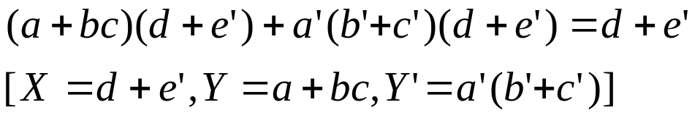

Algebraic Simplification
1. Combining terms
Example:
2. Adding terms using
Example:
3. Eliminating terms
Example:
Example:
Example:

Slide 44
Algebraic Manipulation
  Example: Simplify F = x’yz + x’yz’ + xz.
  F= x’yz + x’yz’ + xz
  = x’y(z+z’) + xz
  = x’y•1 + xz
  = x’y + xz
x
y
F
z
x
y
F
z

Slide 45
Algebraic Manipulation (cont.)
  Example: Prove
  x’y’z’ + x’yz’ + xyz’ = x’z’ + yz’
  Proof:
  x’y’z’+ x’yz’+ xyz’
  = x’y’z’ + x’yz’ + x’yz’ + xyz’
  = x’z’(y’+y) + yz’(x’+x)
  = x’z’•1 + yz’•1
  = x’z’ + yz’
  QED.

Slide 46




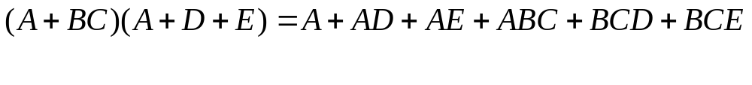
Sum of Products (SOP)
Sum of product form:
Still considered to be in sum of product form:
Not in Sum of product form:
Multiplying out and eliminating redundant terms

Slide 47

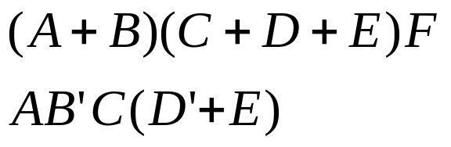
Product of Sums (POS)
Product of sum form:
Still considered to be in product of sum form:

Slide 48
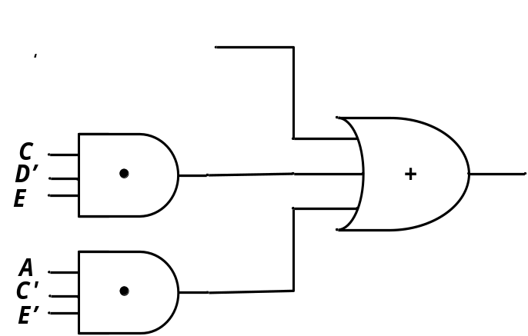

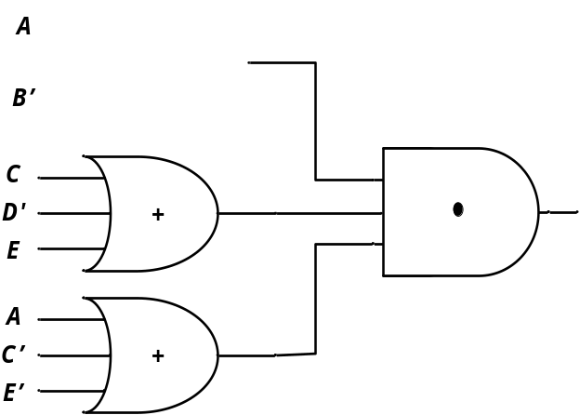

Circuits for SOP and POS form
Sum of product form:
Product of sum form:

Slide 49
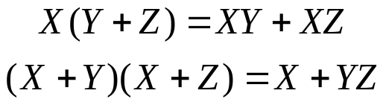
Multiplying Out and Factoring
To obtain a sum-of-product form ➔ Multiplying out using distributive laws



Theorem for multiplying out:
(
X
+
Y
)(
X
'
+
Z
)
=
XZ
+
X
'
Y
(3-3)







If
X
=
0,
(3
-
3)
reduces
to
Y(1
+
Z)
=
0
+
1
∗
Y
or
Y
=
Y.
If
X
=
1,
(3
-
3)
reduces
to
(1
+
Y)Z
=
Z
+
0
∗
Y
or Z
=
Z.
because
the
equation
is
valid
for
both
X
=
0
and
X
=
1,
it
is
always
valid.
Example:



The use of Theorem 3-3 for factoring:
A
B
+
A
'
C
=
(
A
+
C
)(
A
'
+
B
)






Slide 50


Multiplying out (Another Proof)



Theorem for multiplying out:
(
X
+
Y
)(
X
'
+
Z
)
=
XZ
+
X
'
Y
(3-3)








Slide 51
Factoring Expressions
To obtain a product-of-sum form ➔ Factoring using distributive laws
Example of factoring:
AC
+
A
'
BD
'
+
A
'
BE
+
A
'
C
'
DE
=
AC
+
A
'
(
BD
'
+
BE
+
C
'
DE
)
XZ
X
'
Y
=
(
A
+
BD
'
+
BE
+
C
'
DE
)(
A
'
+
C
)
=
[
A
+
C
'
DE
+
B
(
D
'
+
E
)](
A
'
+
C
)
X
Y
Z
=
(
A
+
B
+
C
'
DE
)(
A
+
C
'
DE
+
D
'
+
E
)(
A
'
+
C
)
=
(
A
+
B
+
C
'
)(
A
+
B
+
D
)(
A
+
B
+
E
)(
A
+
D
'
+
E
)(
A
'
+
C
)

Slide 52
Conversion of English Sentences to Boolean Equations
  The first step in designing a logic network:
    Translate English sentences to Boolean Eqns.
      We must break down each sentence into phrases
      And associate a Boolean variable with each phrase (possible if a phrase can have a “true”/”false” value)
  Example:
    Ali watches TV if it is Monday night and he has finished his homework.
    → F = A . B

Slide 53
Main Steps
  Three main steps in designing a single-output combinational switching network:
    Find a switching function which specifies the desired behavior of the network.
    Find a simplified algebraic expression for the function.
    Realize the simplified function using available logic elements.

Slide 54
Example
  Four chairs in a row:
    Occupied: ‘1’
    Empty: ‘0’
    F = ‘1’ iff there are no adjacent empty chairs.
A
B
C
D
  F = (B’C’ + A’B’ + C’D’)’

Slide 55
Example
  F = (B’C’ + A’B’ + C’D’)’
  F = (B+C).(A+B).(C+D)
  = (B+AC).(C+D)
  = BC + BD + AC + ACD
  = BC + BD + AC

Slide 56
Truth Tables (revisited)
  Enumerates all possible combinations of variable values and the corresponding function value
  Truth tables for some arbitrary functions
  F₁(x,y,z), F₂(x,y,z), and F₃(x,y,z) are shown to the right.
x | y | z |  | F₁ | F₂ | F₃
0 | 0 | 0 |  | 0 | 1 | 1
0 | 0 | 1 |  | 0 | 0 | 1
0 | 1 | 0 |  | 0 | 0 | 1
0 | 1 | 1 |  | 0 | 1 | 1
1 | 0 | 0 |  | 0 | 1 | 0
1 | 0 | 1 |  | 0 | 1 | 0
1 | 1 | 0 |  | 0 | 0 | 0
1 | 1 | 1 |  | 1 | 0 | 1

Slide 57
Truth Tables (cont.)
  Truth table: a unique representation of a Boolean function
  If two functions have identical truth tables, the functions are equivalent (and vice-versa).
  Truth tables can be used to prove equality theorems.
  However, the size of a truth table grows exponentially with the number of variables involved.
    This motivates the use of Boolean Algebra.

Slide 58
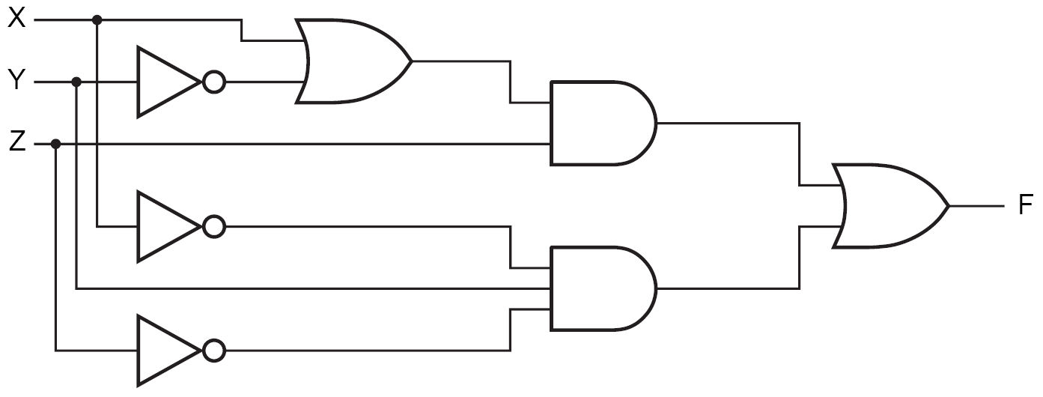
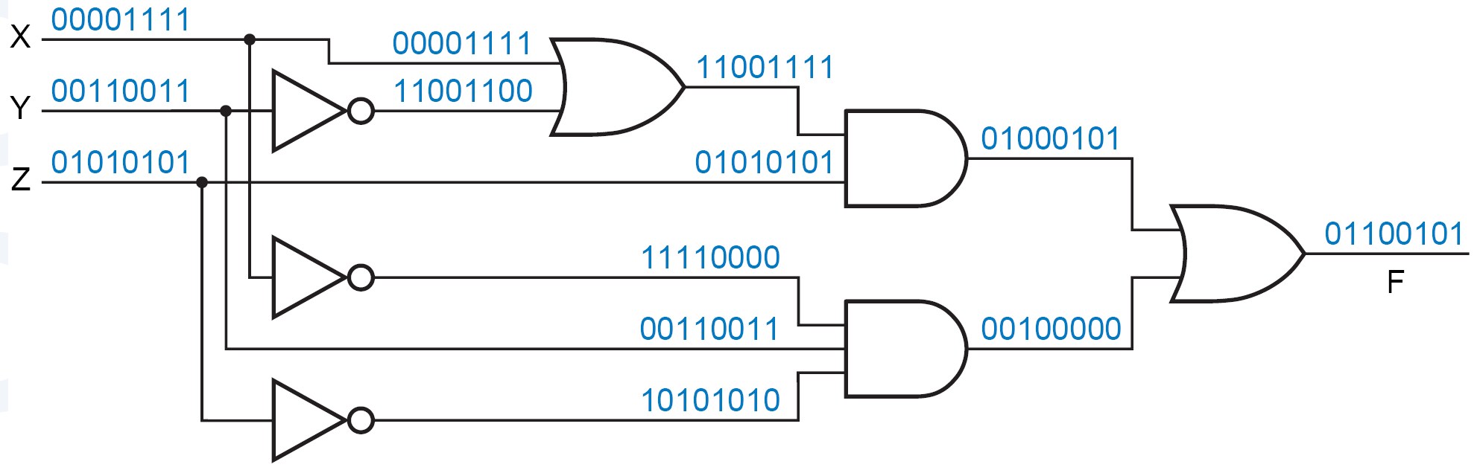
Circuit Analysis
  Circuit to be analyzed:
  Consider all possible combinations of inputs

Slide 59
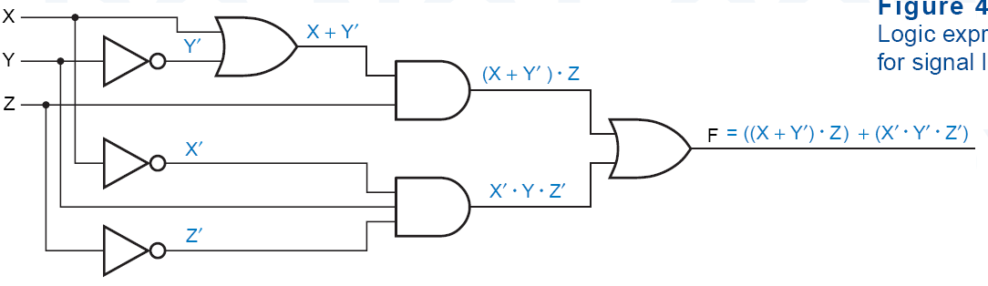
Circuit Analysis
  Circuit to be analyzed:
  Can also name the nodes
N₁ = X+Y’
N₂ = N₁.Z
N₁
N₃ = X’.Y.Z’
N₂
F = N₂+N₃
N₃
F = N₁.Z+ X’.Y.Z’
= (X+Y’). Z+ X’.Y.Z’

Slide 60
Boolean expressions-
NOT unique
x | y | z |  | F | G
0 | 0 | 0 |  | 1 | 1
0 | 0 | 1 |  | 0 | 0
0 | 1 | 0 |  | 1 | 1
0 | 1 | 1 |  | 0 | 0
1 | 0 | 0 |  | 0 | 0
1 | 0 | 1 |  | 0 | 0
1 | 1 | 0 |  | 1 | 1
1 | 1 | 1 |  | 0 | 0
  Unlike truth tables, expressions representing a Boolean function are NOT unique.
  Example:
    F(x,y,z) = x’•y’•z’ + x’•y•z’ + x•y•z’
    G(x,y,z) = x’•y’•z’ + y•z’
  The corresponding truth tables for F() and G() are identical!
  Thus, F() = G()

Slide 61
Complementation: Example
Find the complement of
F(x,y,z) = xy’z’ + x’yz
  G = F’ = (xy’z’ + x’yz)’
  = (xy’z’)’ • (x’yz)’ DeMorgan
  = (x’+y+z) • (x+y’+z’) DeMorgan again
Note:
  The complement of a function can also be derived by finding the function’s dual, and then complementing all of the literals

Slide 62
Complement of a Function
• ↔ +
1 ↔ 0
X ↔ X’
  interchange 1s to 0s in the truth table column showing F.
  The complement of a function IS NOT THE SAME as the dual of a function.

Slide 63
De Morgan’s Law for a Complex Expression
To invert a function,
  Complement all variables and constants,
  Exchange all + ↔ .
Example:
  ((A + B’).C’.D + EF)’
  = ((A’.B) + C + D’) . (E’ + F’)
Note:
  Don’t change operator precedence

Slide 64
Shannon Theorem
  F(x1,x2,…,xn) = x1.F(1,x2,…,xn) + x1’.F(0,x2,…,xn)
  F(x1,x2,…,xn) = [x1 + F(0,x2,…,xn)] .
  [x1’+ F(1,x2,…,xn)]

Slide 65





Boolean vs. Ordinary Algebra
Some of Boolean Algebra are not true for ordinary algebra
Example:
True in ordinary algebra
Not True in Boolean algebra
Example:
True in ordinary algebra
Not True in Boolean algebra
Some of Boolean Algebra properties are true for ordinary algebra too.
Example:
True in both ordinary and
Boolean algebra

Slide 66
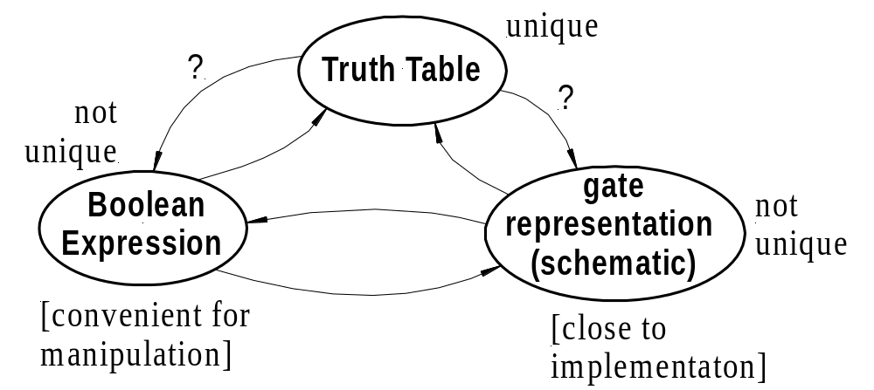
Relationship Among Representations
Theorem:
  Any Boolean function that can be expressed as a truth table can be written as an expression in Boolean Algebra using AND, OR, NOT.
covered
covered
covered
covered
How do we convert from one to the other?
Optimizations?

Slide 67
Ckt (Gate) to Truth Table
  Circuit to be analyzed:
  Consider all possible combinations of inputs

Slide 68
Ckt to Boolean + Boolean to TT
Circuit of logic gates :
Logic Expression :
Logic Evaluation : A=B=C=1, D=E=0

Slide 69
Boolean to Ckt
Combinational Circuit Design:
F = A’ + B•C’ + A’•B’
  connect input signals and logic gates:
    Circuit input signals → from function variables (A, B, C)
    Circuit output signal → function output (F)
    Logic gates → from logic operations
C
A
F
B

Slide 70
Minterms and Maxterms
Minterm:
  a product term in which all the variables appear exactly once, either complemented or uncomplemented
Maxterm:
  a sum term in which ….
  Minterms and Maxterms are easy to denote using a truth table.
x | y | z |  | Minterm | Maxterm
0 | 0 | 0 |  | x’y’z’ = m₀ | x+y+z = M₀
0 | 0 | 1 |  | x’y’z = m₁ | x+y+z’ = M₁
0 | 1 | 0 |  | x’yz’ = m₂ | x+y’+z = M₂
0 | 1 | 1 |  | x’yz = m₃ | x+y’+z’= M₃
1 | 0 | 0 |  | xy’z’ = m₄ | x’+y+z = M₄
1 | 0 | 1 |  | xy’z = m₅ | x’+y+z’ = M₅
1 | 1 | 0 |  | xyz’ = m₆ | x’+y’+z = M₆
1 | 1 | 1 |  | xyz = m₇ | x’+y’+z’ = M₇

Slide 71
Canonical Forms: Unique
  Any Boolean function F( ) can be expressed as a unique sum of minterms (and a unique product of maxterms)
  In other words, every function F() has two canonical forms:
    Canonical Sum-Of-Products (sum of minterms)
    Canonical Product-Of-Sums (product of maxterms)

Slide 72
Canonical Forms (cont.)
Canonical Sum-Of-Products:
  The minterms included are those m_{j}’s such that F( ) = 1 in row j of the truth table for F( ).
Canonical Product-Of-Sums:
  The maxterms included are those M_{j}’s such that F( ) = 0 in row j of the truth table for F( ).

Slide 73
Example
a | b | c |  | f₁
0 | 0 | 0 | 0 | 0
0 | 0 | 1 | 1 | 1
0 | 1 | 0 | 2 | 1
0 | 1 | 1 | 3 | 0
1 | 0 | 0 | 4 | 1
1 | 0 | 1 | 5 | 0
1 | 1 | 0 | 6 | 1
1 | 1 | 1 | 7 | 0
  f₁(a,b,c) = m₁ + m₂ + m₄ + m₆
  = a’b’c + a’bc’ + ab’c’ + abc’
  f₁(a,b,c) = M₀ • M₃ • M₅ • M₇
  = (a+b+c)•(a+b’+c’)• (a’+b+c’)•(a’+b’+c’).
Observe that: m_{j} = M_{j}’

Slide 74
Shorthand: ∑ and ∏
f₁(a,b,c) = ∑ m(1,2,4,6),
  m₁+ m₂ + m₄ + m₆.
f₁(a,b,c) = ∏ M(0,3,5,7),
  M₀ . M₃ . M₅ . M₇.

Slide 75
Conversion Between Canonical Forms
  Replace ∑ with ∏ (or vice versa)
  Replace those j’s that appeared in the original form with those that do not.
Example:
  f₁(a,b,c) = a’b’c + a’bc’ + ab’c’ + abc’
  = m₁ + m₂ + m₄ + m₆
  = ∑(1,2,4,6)
  = ∏(0,3,5,7)
  = (a+b+c)•(a+b’+c’)•(a’+b+c’)•(a’+b’+c’)

Slide 76
Standard Forms (NOT Unique)
  Standard forms are “like” canonical forms,
    Not all variables need appear in the individual product (SOP) or sum (POS) terms.
Example:
  f₁(a,b,c) = a’b’c + bc’ + ac’
  is a standard sum-of-products form
  f₁(a,b,c) = (a+b+c)•(b’+c’)•(a’+c’)
  is a standard product-of-sums form.

Slide 77








Four Alternative Implementations
A
F(A,B,C) = Σm(3,4,5,6,7)
F = A' B C + A B' C' + A B' C + A B C' + A B C
B
Canonical Sum of Products
F
C
1
Minimized Sum of Products
A + B C
F
2
Canonical Products of Sums
F
3
F(A,B,C) = ΠM(0,1,2)
= (A + B + C) (A + B + C') (A + B' + C)

Slide 78
Conversion of SOP from standard to canonical
  Expand non-canonical terms by inserting equivalent of 1 in each missing variable
    x: (x + x’) = 1
  Remove duplicate minterms
  f₁(a,b,c) = a’b’c + bc’ + ac’
  = a’b’c + (a+a’)bc’ + a(b+b’)c’
  = a’b’c + abc’ + a’bc’ + abc’ + ab’c’
  = a’b’c + abc’ + a’bc + ab’c’

Slide 79
Conversion of POS from standard to canonical
  Expand noncanonical terms by adding 0 in terms of missing variables (e.g., xx’ = 0) and using the distributive law
  Remove duplicate maxterms
  f₁(a,b,c) = (a+b+c)•(b’+c’)•(a’+c’)
  = (a+b+c)•(aa’+b’+c’)•(a’+bb’+c’)
  = (a+b+c)•(a+b’+c’)•(a’+b’+c’)•
  (a’+b+c’)•(a’+b’+c’)
  = (a+b+c)•(a+b’+c’)•(a’+b’+c’)•(a’+b+c’)

Slide 80
More Logic Gates
NAND:
  NOT-AND
    Its output = 1, only if both inputs are not 1.
    (A • B)’
  has traditionally been the universal gate in digital circuits.
    It is simple to implement in hardware and can be used to construct the other gates.
A | B | (A.B)’
0 | 0 | 1
0 | 1 | 1
1 | 0 | 1
1 | 1 | 0

Slide 81
More Logic Gates
NOR:
  NOT-OR
    Its output = 1, only if no input is 1.
    (A + B)’
  Can be a universal gate.
A | B | (A+B)’
0 | 0 | 1
0 | 1 | 0
1 | 0 | 0
1 | 1 | 0

Slide 82
More Logic Gates
XOR:
  Inequality
    Its output = 1, only if exactly one input is 1.
    (A ⊕ B)
A | B | A XOR B
0 | 0 | 0
0 | 1 | 1
1 | 0 | 1
1 | 1 | 0
(A ⊕ B) = A.B’ + A’.B

Slide 83
More Logic Gates
3-input XOR:
    Its output = 1, only if one or three inputs are 1.
    (A ⊕ B ⊕ C)
A | B | C | A XOR B XOR C
0 | 0 | 0 | 0
0 | 0 | 1 | 1
0 | 1 | 0 | 1
0 | 1 | 1 | 0
1 | 0 | 0 | 1
1 | 0 | 1 | 0
1 | 1 | 0 | 0
1 | 1 | 1 | 1

Slide 84
More Logic Gates
XNOR:
  Equality
    Its output = 1, only both inputs are equal.
    (A ⊕ B)’
A | B | A XNOR B
0 | 0 | 1
0 | 1 | 0
1 | 0 | 0
1 | 1 | 1
(A ⊕ B)’ = A.B + A’.B’

Slide 85





Theorems for XOR

Slide 86
Problem Solving
  More often, we describe a logic function using the English-language connectives “and,” “or,” and “not.”
Example: CEIT Lift
  The MOVE output is 1 if
    a button in a floor (OUTSIDEB) is 1, and OPENB button is 0
    or a button inside the lift (INSIDEB) is 1 and door lift is closed (CLOSED = 1)
  OUSIDEB is 1 if
    OUTBUTTON1 is 1 or OUTBUTTON2 is 1 or OUTBUTTON3 is 1
  INSIDEB is 1 if
    KEY1 is 1 or KEY2 is 1 or KEY3 is 1

Slide 87
Problem Solving
  Sometimes we have to work with imprecise word descriptions of logic functions,
Example:
  “The ERROR output should be 1 if the GEAR, CLUTCH, and BRAKE inputs are inconsistent.”
  In this situation, the truth-table approach is best because it allows us to determine the output required for every input combination, based on our knowledge and understanding of the problem environment
    e.g., the gear cannot be applied unless the clutch is pressed.

Slide 88
Example
A 4-bit Prime Number Detector
F = Σ_{N3,N2,N1,N0}(1, 2, 3, 5, 7, 11, 13)
=N3′.N2′.N1′.N0 + N3′.N2′.N1.N0′ + N3′.N2′.N1.N0+ N3′.N2.N1′.N0 + N3′.N2.N1.N0 + N3.N2′.N1.N0 + N3.N2.N1′.N0
N3′.N1′.N0 + N3′.N2′.N1 + N3′.N2.N1.N0 + N3.N2′.N1.N0 + N3.N2.N1′.N0
…
براي عبارات پيچيده، کار بهينه سازي سخت تر ميشود.
روشي سيستماتيک و آسان تر: نقشة کارنو
  شما را از جبر بول بي نياز نمي کند.

Slide 89
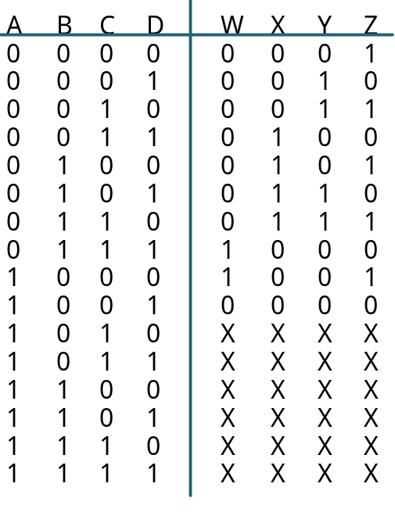
Incompletely Specified Functions
Don’t Care:
  We don’t care about the output values for some intput patterns.
  this fact can be exploited during circuit minimization!
Example:
  BCD incrementer:
Off-set of W
On-set of W
Don't care (DC) set of W
These input patterns should
never be encountered in practice
associated output values are
"Don't Cares"

Slide 90
Don't Cares and Canonical Forms
Canonical Representations of the BCD Incrementer:
Z = m0 + m2 + m4 + m6 + m8 + d10 + d11 + d12 + d13 + d14 + d15
Z = Σm(0, 2, 4, 6, 8) + d(10, 11, 12 ,13, 14, 15)
Z = M1 • M3 • M5 • M7 • M9 • D10 • D11 • D12 • D13 • D14 • D15
Z= ΠM(1, 3, 5, 7, 9) • D(10, 11, 12, 13, 14 ,15)

